Slide 1
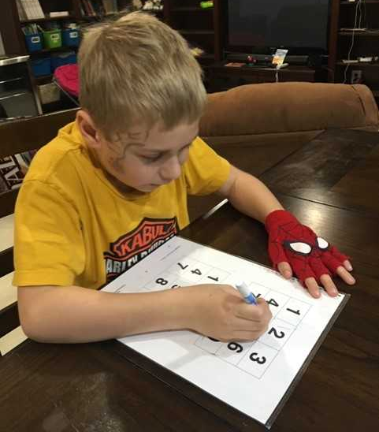
Equipping Minds for Reading Success!
Faith Berens, M.Ed., Reading and Dyslexia Specialist
Equipping Minds Conference, 2020
Notes:
Thanks to Carol; dear friend and colleague
I met Carol probably almost 10 years ago….heard about her doing a workshop in VA and I had done NILD therapy and O-G based reading intervention but my students were running into difficulties, hitting walls, and as well my own daughter was experiencing reading comprehension issues, difficulty with listening in lecture and take notes….so I knew there were processing areas that needed to be addressed….when I went to Carol’s weekend introductory training I knew I had found hope and answers to address weak cognitive skills-bc traditional tutoring and more academics, and accommodations were not going to sufficiently address her struggles. Then when Hayden was a toddler he was experiencing sensory issues, meltdowns, and tinnitus, as well as extreme sensitivity to sound….I knew that Carol’s Equipping Minds Cognitive Development program could provide us hope and success, so we implemented it as part of our homeschooling with both kiddos.
Background-
Public and Private school
NILD and OG
Head Start, Title 1, and Reading Recovery
Literacy Specialist
Homeschooling-HSLDA and private practice (reading diagnostic testing and consulting)
**Share Drew’s story and his mom’s testimonial
Would not write; could not get him to hold a pen or a pencil until we started playing tic tac toe; first we used cubes….but then he wanted to play and use the pen. Then we progressed to being able to do Number Hunt and Animals with the marker.
“EM has enabled my dyslexic son to advance in his reading and processing. He was struggling with remembering phonetic sounds, letters and retaining information in all of his classes. EM was able to target those issues specifically- working memory, visual reversals, and processing speed. The exercises were fun and challenging. After our 3 months, my son started advancing quickly through our reading program, whereas before he was just going at such a slow pace. We are a year and half out now; he is reading chapter books…I would recommend EM to anyone who is struggling academically or cognitively.”
*He had had Early Intervention, Speech/Language and OT
Mom jumped right in; did the primitive reflexes and we plunged in….she bought the materials and watched the videos….no training but started doing it!

Slide 2


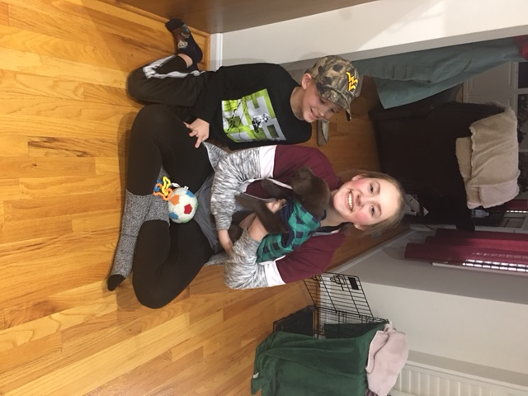
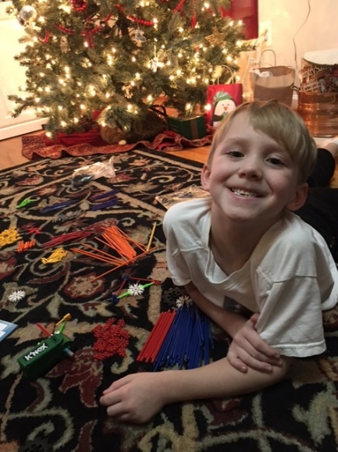
My Family
Notes:
Then when Hayden was a toddler he was experiencing sensory issues, meltdowns, and tinnitus, as well as extreme sensitivity to sound….I knew that Carol’s Equipping Minds Cognitive Development program could provide us hope and success, so we implemented it as part of our homeschooling with both kiddos.
Traumatic birth/Csections
*daughter has had some visual processing difficulty, attention/executive functioning and processing speed and difficulty with remembering/retaining what she would read; Hailey worked with Ashley! Her story!
Hayden-birth trauma, cutis aplasia, APD

Slide 3

Notes:
I just loved Carol and her family so much and her program impacted us/our family and I knew she would just bless so many homeschooling families that I talked her into coming to work for me on my team at HSLDA tiny time; so she answers families’ questions and emails a couple days a week and speaks/serves at some home education conferences to equip parents who are homeschooling on how to strengthen their kids cognitive skills and succeed! She has also helped our attorneys with some families facing litigation by doing some assessments and writing instructional/intervention plans.
*A little bit about what we do-what we offer to homeschooling families; we review test reports, make recommendations, curricula consults, help connect families with therapists, tutors, etc. We speak across the country on learning, homeschooling, to equip families so that homeschooling is possible no matter the diagnosis.

Slide 4
We Provide Our Members…
Individualized phone consultations
E-mail support
Newsletters
Brigance assessment kits
Access to Private Consultant Locator/Database of
homeschool friendly professionals
Struggling Learner Website resources
Webinars/Workshops
Prayer support and encouragement
Compassion grants
Notes:
We are here to help you with your education-during School At Home,
Homeschooling or transition from private or public school to homeschool!
Be sure to check out HSLDA’s Quick Start Guide
HSLDA Educational Consultant FB page
And the new MomPossible.org website!
Members can call and speak to any of our HSLDA Educational Consultants, and *Dr. Carol offers HSLDA a free 30 minute consultation!!

Slide 5
Exceptional Learners
1 in 5 children Have Learning and Attention Issues
Dyslexia
Autism Spectrum
ADD - ADHD
Dysgraphia
Dyscalculia
Down Syndrome
Neurodevelopmental Disorder
Intellectual Disability
Fetal Alcohol Syndrome
Gifted
Notes:
Dyscalculia-
Subitizing-rapidly recognizing/naming numbers or basic number sense
Poor visual spatial skills
Poor ability to conceptualize
Can’t “picture” values
Difficulty learning and retaining math facts
Difficulty or inability to picture numbers in your minds eye/chalkboard in your brain!

Slide 6
Exceptional Learners
Intellectual Disabilities
6.5 million US
200 million globally
The employment gap, difference between the employment percentage for people with disabilities (35.9%) and people without disabilities (76.6%), was 40.7 percentage points.

Slide 7
Why is learning so hard?
Equipping Minds for Reading, Math, Writing Success
Bridging to Academics
Classroom Connections
What can this program look like at home?
Notes:
NOTES:
Goals for this session-Particularly how EM equips students for success in reading

Slide 8

To learn to read is to light a fire; every syllable that is spelled out is a spark “
Victor Hugo
Notes:
So-let’s turn to the area of reading!
HOW DO WE READ?
Reading In the Brain by Stanislas Dehaene
p. 11-
Reading (and writing) which are reciprocal processes are complicated and includes subordinate processes. According to Harold Blomberg, Swedish psychiatrist and author of Movements That Heal and The Rhythmic Movement Method states:
“In order for us to be able to read and write there must be a sensory process that receives impressions (Letters, words or signs) and transfers them to specific areas of the brain in the neocortex…many different areas of the neocortex must work together in a neural network in order for the reading process to function…the eyes must be able to work together (binocular vision) and move properly, and they must be able to change the focus of vision….Motor abilities are fundamental for visual skills, such as accommodation (changing between near and far distance), binocular/eye teaming, convergence, vision and eye movements.”
**Visual screening in WB pages 16-22
How to do visual screening!
WB pages 26 and 27-visual processing system and vestibular and auditory systems really connected!
“Reading always requires specialized visual system for shapes of letters and connecting to speech sounds.”

Slide 9

Why do Students Struggle?
Fluid Reasoning Deficiencies
Working and Long-term Memory Deficiencies
Visual-Spatial Deficiencies
Processing Deficiencies
  Auditory
  Visual
  Language
Comprehension Deficiencies
Lack of Primitive Reflex Integration
Notes:
We need to pinpoint the weak areas so we can target those and strengthen..
If your computer is running slow, you will clean it up or maybe add more memory storage

Slide 10

What is Reading?
Necessary skills for reading?
Notes:
Reading is a complex process of making meaning from print. It includes processing strategies, problem-solving, and thinking.
Decoding, or applying phonics rules in order to “sound out” words is one small piece of the big reading puzzle. Phonics is one system good readers use in order to make sense out of print.
**Phonics alone is not enough!
However, if children don’t understand what they read, then they are not truly reading.
Understanding language is vital to being a skilled reader!

Slide 11
Key Predictors or Reading Ability
Phonological/Phonemic Awareness
Receptive and Expressive Language Vocabulary
Rapid Automatic naming abilities/Naming Speed
Letter name knowledge
Verbal Short term memory
Home Literacy environment
Notes:
*Refer to testing manual and read quote about Rapid Naming Speed, p.92
*With population that are labeled/diagnosed with dyscalculia (specific learning disability in math), they often weak in what is termed “subitizing”. *Other key skills such as sequencing, holding and following multi-step directions, and visual-spatial skills are weak.

Slide 12
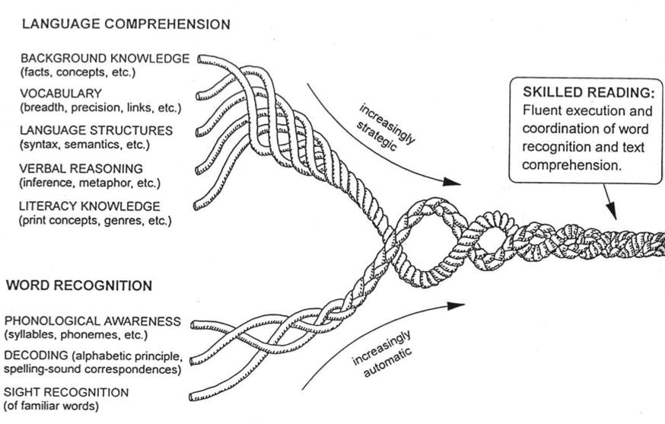
Reading Rope
created by Hollis Scarborough
Photo from: https://courses.lumenlearning.com/suny-hccc-childrenslit/chapter/the-simple-view-of-reading
Notes:
The Reading Rope (created by Hollis Scarborough, 2001, researcher of early lang. development) is a graphic representation of the many strands that are woven into skilled reading.
It shows how reading comprehension is a result of two main components – Language Comprehension and Word Recognition
**Refer to Annals of Dyslexia Journal , Ring and Black’s study, “Multiple Deficit Model of Dyslexia”

Slide 13

Visual
Visual Discrimination
Visual Figure-Ground
Visual Memory
Convergence
Tracking
Notes:
Visual Discrimination – the ability to distinguish likenesses and differences among forms and symbols.
Ability to see what’s the same and what’s different. i.e. difference between b and p, n and u.
Classroom behavior: confuses letters, numbers and words.
EM. WB pages 89-93
Extreme Memory with letters on 3 and 4 grid board!,
Visual Figure- Ground – Ability to focus on one figure allowing all else to drop into the background.
Classroom behavior – kids don’t see the bold print or italics in a text book. Trouble with lines.
Stroop Animals, Stroop Effect, and Stroop Test Mini
ARROWS, Letters, Vowel Hunt and Number Hunt;
Mixed Letter and Number Hunt, p. 111 and 114!
Visual Memory – ability to recall an image or sequence of what has been seen.
Classroom behavior: Dif. Recalling letter formations and symbols. Dif. Learning sight words. Spelling.
SPELLING CONNECTION EM Workbook, p. 135-137
Convergence - Convergence insufficiency is a condition in which your eyes are unable to work together when looking at nearby objects. Eye teaming problem. Interferes with a person's ability to see, read, learn, and work at near (close distances). Vision therapy. Can have 20/20 vision and still have convergence insuf.
Tracking - In order to use our vision efficiently, the eyes must move accurately, smoothly, and quickly from place to place. With tracking problems, eye movements are slow, inaccurate, or require head or finger movement to help the eyes track. This can interfere with reading fluency and comprehension, copying, handwriting, and sports performance.
See a developmental optometrist for evaluation for any of these. Also, see Diane Craft’s informal evaluations on our struggling learners website under vision.
Visual Acuity is the clarity or clearness of vision. (i.e. eye chart for 20/20 vision)

Slide 14

Auditory
Auditory Memory
Auditory Discrimination
Sound Sequencing
Phonological Processing
Phonemic Awareness Skills
Notes:
Auditory memory – the ability to retain or recall auditory experiences.
Learning behavior: Dif remembering sound/symbol relationships; Dif sequencing sounds and words
Auditory memory game – Going on a picnic
**Equipping Minds-p.121 Auditory Recall and Poetry Memorization, p.161
Listen My Children
*Auditory Discrimination – the ability to recognize the differences between sounds and the sequence of sounds. Grasp is gasp, seventeen and seventy, parasite is periscope, porter is reporter, ancestor is aunt’s sister, dome is dorm, ten is tin, weak phonemic and phonological awareness. Reading, speaking and spelling at risk.
Sound Sequencing – ability to recall the order of sounds. Can be related to aud. Discrim.
Difficult to decode (or spell) if can’t sequence sounds. In early stages of lang. dev. kids have diff. sequ. sounds.
Phonological Processing – ability to divide spoken language into units, such as words and syllables.
Has to do with hearing sounds. Phono=sound

Slide 15
Phonological Processing/Phonemic Awareness
Phonemic awareness is the ability to hear and manipulate the sounds within words
Phonemic Awareness skills include:
Rhyming (recognizing and generating)
Segmenting sounds, Phoneme isolation, blending and manipulation
Syllable awareness and counting
Notes:
Phonemic Awareness Skills – Very important part of learning to read! most advanced part of phonological processing. Child’s awareness of individual phonemes – the smallest units of sounds – in spoken words, and ability to manipulate those sounds.
https://blog.maketaketeach.com/how-to-make-a-phonics-phone/
EM WB p. 141-144 and PHONICS PHONE; show dinosaur counters; linking cubes for how to break words into sounds
Activities and Games: 1.Which words rhyme? Fox, box; horse, house.
2. Onset and rime: /m/ /at/ mat; and /p/ /a/ /t/ pat;
3. What sound do you hear first in book? /b/ What sound do you hear last in sit? /t/
4. Count the number of sounds you hear in mouse? /m/ /ou/ /s/ 3
5. Say the word cat without the /c/. /at/
Other programs/resources:
Phonemic Awareness for Young Children Marilyn Jager Adams
The Struggling Reader PAT activites and assessment
Creative Teaching Press
The Logic of English, Earobics

Slide 16
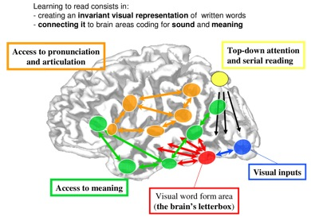
Brain’s Architecture
For Reading
Notes:
“Now that we understand exactly which circuits are changed by reading education, we may start thinking about how to optimize this process, particularly for children who struggle…the present results dovetail nicely with prior research, which leaves little doubt that the systematic teaching of how letters map on to speech sounds may favor the rapid establishment of the brain’s visual and phonological circuits.” Dehaene,
*The Brain’s Letter Box-
It is the visual word form area; “fusiform gyrus”-one function is storing representations for the faces of people we are familiar with/know. it is where symbols of writing are stored;
visual recognition of letters and their combinations
Learn shapes of letters
Phonemes get mapped to the letters
**I love that the Equipping Minds program works on actually remapping/rewiring the brain and getting all these areas “lighting up”/firing!
Broca’s area (faculty of speech)-left frontal area
Wernicke’s area (Linguistic)
Visual-occipital lobe
Auditory-temporal lobes
Sensory impressions-front part of parietal lobe

Slide 17
My child can decode the words but doesn’t understand what he reads.”
Notes:
Comprehension problems are often based in language. Refer to reading rope.

Slide 18
What is comprehension?
Understanding
Making meaning
Making imagery
Translating language (oral or written) into a mental gestalt/picture
Notes:
Comprehension problems are often based in language. Refer to reading rope.
STARE JR>
*Aristotle’s 10 Categories of Being and P. 153-Working Memory Exercise for Comprehension and Daily Reading Sessions
Use graphic organizers, mind maps, talkies, V and V

Slide 19

Language
Background Knowledge
Vocabulary
Language Structures
Verbal Reasoning
Print Awareness
Notes:
**Teaching Struggling Readers, P.47 Vygotsky and Luria-Quote
Stir up background knowledge –
**Spend a lot of time talking about pictures!
I see you turning to page 149 in your EM Workbook! And page 192-193!!
*Remember, go from known to new! Brain can only work with what is known…input, input, input; help the student to bridge and make connections. Build on what they like/interest area. With Chase-we started with animals!
**Calendar pictures with 10 Categories of Being
Bridged everything from ANIMALS; *Show books; tic tac toe with Animals; read parts of Charlotte’s Web; Animal poems and informational books
STARE JR cards-
SPOT IT cards-
Classified Animals-See WB pages 171-173
**Really basic skill is automaticity with naming objects!
RAN deficit is frequently found in young children with dyslexia; it is know that it measures more than just processing speed and articulation speed and is only moderately correlated with phonological skills (Norton and Wolfe, 2012).
“Norton and Wolfe have suggested it is a microcosm of the reading system, providing an index of one’s ability to integrate multiple neural processes.”
**SET-Great for visual processing, visual discrimination and language/rapid automatic Naming speed, as well as vocabulary/concepts (empty/solid/filled in)
DECK of CARDS, p.78
Good readers draw on prior knowledge and experience to help them understand what they are reading. Make connections.
Connect books/text to field trips, outings.
Use videos or DVDs and media
Use book example to demonstrate how.
Vocabulary – provide brief explanation of vocab during read aloud “When someone is annoying it means they are bothering you”. Use visual props and pictures. Child needs to know vocabulary to see if the word makes sense to the context.
Language structures –sentence construction and grammar; semantics (meaning); **BLINK-the structure of language
Verbal reasoning – understanding inference; metaphor; read aloud and discuss story
Metaphor ex. “He is a walking encyclopedia”.
FABLES
POETRY
Print awareness refers to a child’s understanding that written language is related to oral language.
It is closely related to word awareness, the ability to recognize that spoken words have a written form.
Print is a means of communication.
Print is organized in a specific and predictable way
Reliable predictor of future reading achievement
Recog letter vs number
Recog letter vs word
Give book and ask questions “show me front of book, title of book, a letter, a word, first word of a sentence, etc.
For struggling readers whose difficulties involve language comprehension, evidence suggests that interventions that include oral language comprehension are more effective than interventions focused on reading comprehension alone (Clarke et al., 2010).

Slide 20




Current Interventions
Content Remediation
Learning Strategies
Medications
Occupational Therapy
Physical Therapy
Speech Therapy
Level the Playing Field
IEP Accommodations
Notes
Preferred Seating
Notes / Scribe / Reader
Extended Time for Tests
Equip learners to play on the same field.
Support, Small group, or Co-taught classes
Modified Assignments
Notes:
Typically in schools we offer general interventions, coping strategies, more academic tutoring, some related services, and of course accommodate the student….but we never really get to the underlying causes of the learning difficulties.
With homeschooled families or others-we often see where they have tried a little of this, maybe they did some vision therapy or they had some EI with speech and then they got some reading help…but they went on with some basic supports in place and then hit a wall and really start falling behind that 4th/5th/6th grade year…..and the gap just keeps widening.

Slide 21

Cognitive Functioning:
Cognitive Skills include:
Memory (short term, working, and long term)
Attention (sustained, visual and auditory selected, divided, and flexible)
Processing (General, language, visual, and auditory)
Logic and Reasoning (make a plan, prioritize, analyze and solve)
Comprehension (understanding and remembering language, “seeing” details—imagery, or “the movie in your mind”)
Notes:
Mental processes; thinking
Naming Speed, language processing problems, and poor working memory contribute to many learning difficulties! *But these cognitive functions can be changed! We know this- because of Dr. Reuven Feuerstein’s work, neuro-science, brain imaging, and the ground-breaking scientific research that Dr. Brown has done!

Slide 22
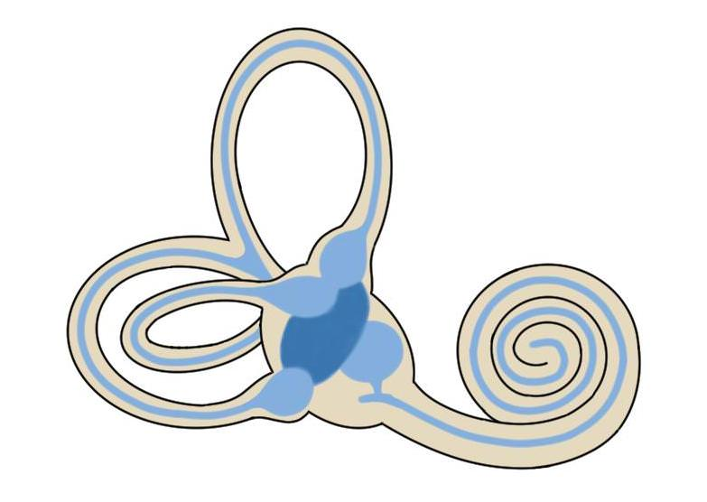



Equipping Minds of Learners
A Holistic-Integrated Approach
Nutritional Therapy
Primitive Reflex Therapy
Vestibular Therapy
Cognitive Development Therapy
Sound Therapy
Mediated Learning Experience
Notes:
Especially powerful-because it is wholistic!
specially recorded programs of highly filtered classical music are used to rehabilitate the ear and stimulate the brain. Sound Therapy stimulates the ear by presenting it with constantly alternating sounds of high and low tone within the complex structure of classical music. Stimulation via the sensory pathways re-maps the brain, improving the way we understand and process sound. The brain, in turn, sends signals back to the ear to improve its function. As the ear becomes open and receptive to high frequency sounds these are then passed on to the brain. Research has shown that brain function is improved through high-frequency sound. Participants will also listen to sound therapy.
The teacher is a mediator who invites the learner to
identify a problem, to analyze it, to use inductive thinking processes to develop a strategy
for its solution, and connect it to other knowledge networks. Teachers who apply these
principles of mediation enable learners to find a greater level of success as independent and active learners.43
Nutrition exercise
Cognitive development
Sensory development
Motor development

Slide 23
Equipping Learners to Play on the Same Field
Intervention:
Cognitive Development Therapy
Results: Follow Multi-step Directions
Visualize
Letters
Numbers
Images
Reading/Spelling
Math
Comprehension
Impacts
Improves Behavior and Language

Slide 24

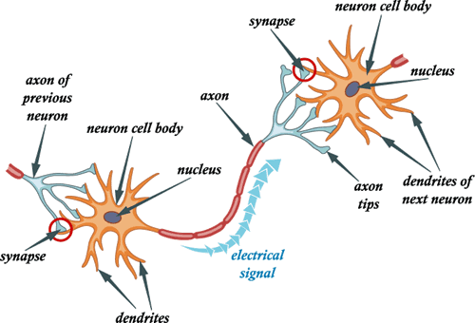
Rewiring the Brain
Estimated: 100 Billion Neurons
100 Trillion Neural Connections
Neurons that fire together wire together

Slide 25

Neuropathways are Like Hiking Trails…
Pathways can be created and strengthened with human mediation
Changes in pathways require intensive therapy
  Repetition and practice everyday
Human mediation takes learners beyond natural limitations enabling them to reach their full cognitive potential.

Slide 26

Equipping Minds
Creates and Strengthens:
Neuropathways
PROVEN
Underdeveloped Cognitive Learning Skills
  Auditory and visual processing
  Working and long-term memory
  Comprehension
  Attention
  Logic
  Reasoning
Notes:
specially recorded programs of highly filtered classical music are used to rehabilitate the ear and stimulate the brain. Sound Therapy stimulates the ear by presenting it with constantly alternating sounds of high and low tone within the complex structure of classical music. Stimulation via the sensory pathways re-maps the brain, improving the way we understand and process sound. The brain, in turn, sends signals back to the ear to improve its function. As the ear becomes open and receptive to high frequency sounds these are then passed on to the brain. Research has shown that brain function is improved through high-frequency sound. Participants will also listen to sound therapy.
The teacher is a mediator who invites the learner to
identify a problem, to analyze it, to use inductive thinking processes to develop a strategy
for its solution, and connect it to other knowledge networks. Teachers who apply these
principles of mediation enable learners to find a greater level of success as independent and active learners.43
Nutrition exercise
Cognitive development
Sensory development
Motor development

Slide 27


Rewiring the Brain
Hard Work Ahead
Intensive Therapy 30-60 minutes/day
5 days a week
12 – 24 weeks
Notes:
*In homeschools, some families do this 4 days week and have one day a week they go to co-op. Others are implementing it at co-op as a class!
How do we fit this in?
Private schools-helping/consulting with a private school in our area and one suggestion I had was to train the staff/teachers in the processing games; use these at recess and after lunch or at the start of the day for warm ups. Same can go for homeschool.
Have history teacher do the Presidents-or do before your history lesson at home;
We play Quitch, Set, and Color Code during our math lesson time weekly.
**Some “EM’S IS BETTER THAN NO EM’S!”

Slide 28

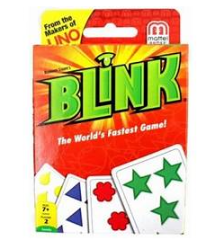
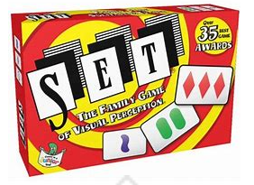
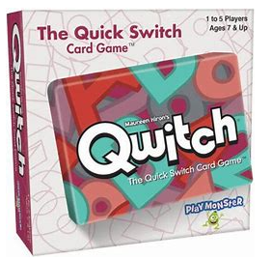
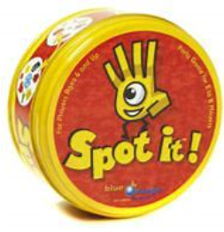

Equipping Minds of Learners
Cognitive Development Exercises:
Interactive Games
Paper-and-marker activities
Progressive / challenging organization
Learners are encouraged to “think aloud” and verbalize:
  processing
  thinking
Intensive Therapy
Notes:
The teacher is a mediator who invites the learner to
identify a problem, to analyze it, to use inductive thinking processes to develop a strategy
for its solution, and connect it to other knowledge networks. Teachers who apply these
principles of mediation enable learners to find a greater level of success as independent and active learners
**Model Color Code-with me and Carol or me and Clayton?
**Set-
Tell me what you are thinking? If we have ____, what will we need to complete the STE?

Slide 29
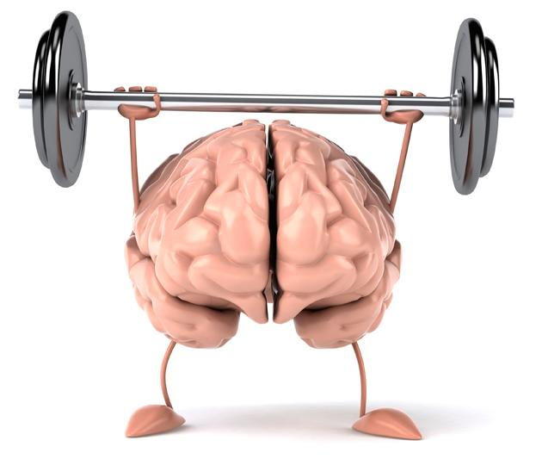


Equipping Minds of Learners
Game: Xtreme Tic Tac Toe
Cognitive Skill: visual memory, auditory processing, working memory, logic and reasoning
If you were me, where do you see me going?
I see myself on 5. Where do you see yourself?
I see myself
winning
Tic Tac Toe with 1, 4 and 7.
I see myself on 9. Where do you see yourself?
To block you, I see myself on 7.
I see myself on 4.
I see myself on 3.
I see myself on 1.
I see you going on 7.

Slide 30
Why do Students Struggle?
Fluid Reasoning Deficiencies
Working and Long-term Memory Deficiencies
Visual-Spatial Deficiencies
Processing Deficiencies
  Auditory
  Visual
  Language
Comprehension Deficiencies
Lack of Primitive Reflex Integration
Notes:
A couple of the biggest areas of weakness that I see/read in test reports is slow processing speed and weak/poor working memory-and these areas are never (hardly ever!) addressed in traditional schools or intervention plans.

Slide 31
Definition of Working Memory
“The ability to hold in mind and mentally manipulate information over short periods of time.”
Tracy Alloway,
leading expert on
working memory

Slide 32

Working Memory & Executive Functions – the Brain’s Conductor
Prioritizes and processes information, so you can ignore what is irrelevant and work with what is important.
Holds on to information so you can work with it.
Notes:
Tracy and Ross Alloway, The Working Memory Advantage
“Conductor of daily symphony of information”
Two main functions:
1. Prioritize and process information (allowing you to ignore some)
2. Hold on to information so you can work with it/do something with it.
(Episodic memory-long term (file cabinet)
Short term memory-like a note pad)

Slide 33
Working Memory Checklist
Difficulty remembering and following instructions
Difficulty paying attention
Difficulty reading and reading comprehension
Difficulty learning math facts and multi-step math problems
Difficulty remembering factual information
Omits words when writing sentences
Has difficulty integrating new information with prior knowledge
Slow processing
Notes:
To be able to read successfully, a child needs to connect letters with the correct sound, put them together to form a word, keep that word in mind as he reads the next word, string all the words together to form a sentence, and then figure out the meaning of all those words.
A poor working memory can affect the child’s ability to acquire phonics, as it takes a strong working memory to be able to take apart and analyze sounds in words.
Work on your child’s phonemic awareness
Use a reading program that incorporates all modalities - visual, auditory, kinesthetic, and tactile. This could include music, motion, pictures, story.

Slide 34
What research says about reading instruction:
Phonemic awareness skills and letter naming are the two most important predictors of reading success
  About 75% of all people will learn to read no matter the type of instruction/methodology
  Systematic, explicit, direct instruction in phonics is the best approach to teaching reading
  Students need sight word instruction, as well as phonics instruction
  Repeated readings and increased reading experiences help students improve in decoding and fluency
  Students positively benefit from being taught morphology (roots of words)
Notes:
Letter Naming:
EM WB pages:
**Letters, p. 89-93
Vowel Hunt, p.98 and 99
Quitch with Letter Names and Sounds

Slide 35
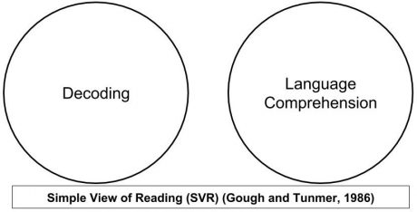
Simple View of Reading
Notes:
Created in response to the Reading Wars
Phonics camp vs. Whole Word/Whole Language

Slide 36

5 Pillars of Reading Instruction
Phonemic Awareness
Phonics
Fluency
Vocabulary (Language)
Comprehension
*Spelling/Writing
Notes:
All areas inter-related.
When remediate one area, other areas may improve.
Fluency – ability to read orally with appropriate rate, accuracy, and proper expression and phrasing.

Slide 37
Solid Teaching Strategies
Encouraging and positive
Mediated Learning
Connected Text
Multi-sensory, explicit and systematic teaching; letter/sound
Repetition and Practice
Timed Reading, Timed Repeated Readings
Notes:
Recoding—reading/sounding out over and over is helpful; over-learning words (taking words to fluency); worst readers read the least—and they need massive amounts more of reading; have to have a huge amount of reading at easy and instructional levels in order to get better!
*Neurological Impress Method in Right Ear; use phonics phone
Connected Text: Words that are linked (as opposed to words in a list) as in sentences, phrases, and paragraphs.

Slide 38

Play Games
Read Aloud
Echo Reading
Choral Reading
Shared Reading
Notes:
Let them read sometimes, but make it a pleasant time.
Cuddle time
**Refer to EM WORKBOOK Pages-Reading pages!!
Model
I will help you; I’ll take a turn, let’s do it together; I take a turn, now you take a turn…..
Stop to let them narrate or dramatize the reading, retell, use little finger puppets or stick puppets.
Leave time for discussion. Enjoy the experience!
**Most people will gradually learn how to read and get better at it by more practice-becomes automatic and then we have what reading researchers have termed the “Matthew Fact”-the rich get richer-the good readers get better and better but poor readers have reduced reading experience and the gap gets wider.

Slide 39
Reuven Feuerstein, Clinical and Cognitive Psychologist 1921 – 2014)
Structural Cognitive Modifiability
1. Human beings are shaped by:
      Environment
      Human Biology
      Mediation
5 Decades
PROVEN
SCM
Mediation Learning Experience
Instrumental Enrichment
2. Intelligence is adaptive
2000+ Research Studies
3. The brain is plastic and can generate new structures through external and internal factors.

Slide 40




Equipping Minds: Transforming Learners
Strengthens:
Don’t Quit
A
Communication
Academics
Perseverance
Evaluation
Life
Excellent
Good
Average
Skills
Relationships
Job Performance
Notes:
So, I love the EM curricula and think it is so powerful particularly for home educators to implement at home-because it is wholistic and will impact students positively in all these areas so that they can reach their full, God-given potential.
**Share about Chase!
The most noticeable difference for me is his spoken communication. He is really talking a lot more, and using longer sentences and bigger words. He just seems overall more engaged in conversations, which is great! I have also noticed an improvement in his spelling. In fact, just the other day, his brother asked Taylor (older sister) how to spell the word "wearing", and Chase shouted it out! That was probably the first time in Chase's life that he knew something his siblings did not. It's always the other way around. I made a really big deal about it and gave him a million hugs because I was so proud of him. Just the fact that he took a risk to speak up, didn't shy away from it, and had the confidence to know he was correct! Amazing!
I will say there is one area where he still really struggles, and I'm seeing it a lot now that they are doing distance learning for his school. He still has a very hard time understanding what is being asked of him, or what the directions are telling him to do. For example, he will given a passage to read, and then asked "Was there something about the way the character responded that surprised you?" Chase has no clue what the teacher is asking. We see this with math word problems, too.

Slide 41
Implementation Models
Accessible, Affordable, and Enjoyable
One – on – One Homeschool or private practice
Small Group
Whole classroom
Private Schools
Public Schools
Before/After School Care
Recreational Therapy and Centers/Communities
Private Practice therapy

Slide 42
Assessing Reading to Determine Difficulty Areas:
San Diego Quick Word Test
Eckenwiler website, www.TheStrugglingReader.com
Rent/Buy Brigance Comprehensive Inventory of Basic Development
DORA test on-line
Curriculum-based reading placement tests
Book, 3-Minute Reading Assessments (Scholastic Publishers)
Reading specialist or private practitioner to do formal and informal reading assessments
Notes:
Assessment is key; Assessment helps us to know what to teach; illuminates gaps, weaknesses and strengths, and should be used as a tool—for how to help the learner.
Why is reading hard? What is blocking reading? Is it language skill/language processing? Could it be a visual processing problem, or auditory processing? Is it the level of material does not match where the child is in his reading skills? Is it fluency/rate? Could it be working memory or slow processing speed? Is the child able to decode and reads at an acceptable rate but not comprehending? (is it they are not making images?)
My assessment battery includes:
TOWRE
GORT-
Compare/contrast silent vs. oral reading comprehension
LAC-Lindamood Auditory Conceptualization
PAT-Phonemic Awareness Test
*Naming Speed with Blink
Investigate quick/automatic naming of letters, colors/shapes
Alloway Working Memory
CTOPP
Screeners for dyslexia
Barton
Lexercise
Dynaread
My assessment battery includes:
TOWRE
GORT-
Compare/contrast silent vs. oral reading comprehension
LAC-Lindamood Auditory Conceptualization
PAT-Phonemic Awareness Test
*Naming Speed with Blink
Investigate quick/automatic naming of letters, colors/shapes
Alloway Working Memory
CTOPP
.

Slide 43

Auditory Processing
Notes:
Refer to aud. slides

Slide 44
Auditory Checklist
Difficulty remembering sight words
Naming Skills- trouble retrieving names of letters, words, people, and things.
Expressive language- laboring over verbal expression.
Difficulty with phonics- trouble remembering sounds of letter combinations such as ‘au’ or ‘oi’.
Difficulty applying phonics rules in a reading setting.
Sounding out the same word over and over in the same passage.
Notes:
Difficulty remembering sight words, including;
Trouble retrieving names of letters, words, people, and things (naming skills)
Laboring over verbal expression (expressive language)
Difficulty with phonics, including:
Trouble remembering sounds of letter combinations such as “au,” “oi.”
Difficulty applying phonics rules in a reading setting.
Sounding out the same word over and over in the same reading passage.

Slide 45
Auditory Checklist
Spelling difficulties, including:
  Trouble spelling phonetically (the child may spell “team” as “tie” or “went” as “wat.”)
  Spelling the same word differently each time.
Difficulty sequencing sounds, including:
  Trouble learning and retaining days of the week and months.
  The child guesses at words because reading longer words is very hard.
  The child puts extra sounds in a word (ie.- contribution becomes contribu’ta’tion), “band” becomes “brand.”

Slide 46
Auditory Checklist
Difficulty saying longer words:
  Transposing letters: “animal” is “aminal;” “magazine” is “mazagine;” “suddenly” is “sundenly.”
  Avoiding difficult words when speaking.
The child’s silent voice disappears:
  He or she subvocalizes when reading silently, or needs to read aloud to understand a passage.
  He or she needs to repeat the alphabet in his head when writing it out.

Slide 47
Auditory Checklist
Difficulty with speech, including:
  Trouble articulating many sounds.
  Exhibiting language delay.
Difficulty understanding verbal instruction:
  He or she needs to ask for directions to be repeated frequently.
  He or she says “what” a lot.

Slide 48
Auditory Processing Resources~
Language/Speech Therapy
Equipping Minds Cognitive Development Curriculum
Sound Therapy International
LiPS program/intervention
FastForWord- www.gemmlearning.com
Earobics- www.superduperinc.com
Sounds Abound- by Catts and Williamson available at www.linguisystems.com
When the Brain Can’t Hear- by Dr. Terri Bellis
Auditory Integration Training- www.aithelps.com

Slide 49
Visual Processing

Slide 50
Visual Processing Checklist
Reading reversals
Skipping of small words when reading.
Needing to use finger to track after age 7.
Oral reading that is smooth at the beginning of the page, but more labored the longer a child reads.
Experiencing eye fatigue shortly after reading begins. (watery eyes, rubbing eyes)
Yawning shortly after reading begins.
Continuing to struggle even after being prescribed eye glasses.

Slide 51
Visual Processing Resources~
Equipping Minds Cognitive Development Program
Vision Therapy
Visual tracking exercises
Dianne Craft’s Brain Integration Therapy
Colored overlays, easy reader windows, and text “trackers”
Irlen’s Reading By the Colors program (Irlen Syndrome)
Low Vision resources (www.hslda.org/strugglinglearner under Resources tab)
Notes:
See developmental optometrist, not just regular eye acuity exam (20/20)
Also, see Diane Craft’s informal evaluations on our struggling learners website under vision.
Visual Acuity is the clarity or clearness of vision. (i.e. eye chart for 20/20 vision)

Slide 52
Language Processing

Slide 53
Language Processing Checklist
Expressive Language
Have a hard time putting words together into sentences
Have difficulty finding the right words when talking
Leave words out of sentences when talking
Have a vocabulary that is below the level of other children the same age
Use certain phrases over and over again, and repeat (echo) parts or all of questions
Notes:
A child with an expressive language disorder has problems using language to express what he is thinking or needs.
A child with both of these disorders has to deal with understanding language and using language to express his thoughts.
A speech and language therapist can help a child who has these difficulties with language. For a list of speech pathologists in your area, please visit www.hslda.org/strugglinglearner/Consultants/ for a database
Expressive/Receptive Language Disorder
“Talkies” Teacher’s Manual – establish connection between language and mental imagery.
Simplified version of the Lindamood-Bell “Visualizing and Verbalizing” program. It is aimed at younger or more severely language disabled students such as those with autism. Multisensory, step-by-step format will help develop oral language computation and expression.

Slide 54
Language Processing Checklist
Receptive Language
A hard time understanding what other people have said
Problems following directions that are spoken
Problems organizing their thoughts
Notes:
A child with receptive language disorder has difficulty understanding language.
A child with both of these disorders (mixed receptive-expressive language disorder) has to deal with understanding language and using language to express his thoughts.
½ children with mixed receptive-expressive language disorder have difficulty in reading.
A speech and language therapist can help a child who has these difficulties with language.

Slide 55
Key Websites & Resources for Reading
Building The Reading Brain by Wolfe and Nevills
Reading In the Brain by Stanislas Dehaene
Teaching Struggling Readers by Carol Lyons
International Reading Association, www.ira.org
International Dyslexia Association, www.interdys.org
www.TheStrugglingReader.com
Timothy Rasinski, www.timrasinski.com
Reading Rockets, www.readingrockets.org
Reading Lady, www.readinglady.com
www.literacyconnections.com

Slide 56

Notes:
We are here to help you with your education-during School At Home,
Homeschooling or transition from private or public school to homeschool!
Be sure to check out HSLDA’s Quick Start Guide
HSLDA Educational Consultant FB page
And the new MomPossible.org website!
Members can call and speak to any of our HSLDA Educational Consultants, including Dr. Carol Brown!

