Slide 1
Equipping Minds
By Dr. Carol Brown
Helpful Tips
Most Important Rule…HAVE FUN!!!
Just start! Trust the process.
Start where the student is. We can only train the brain with what the brain already knows.
Don’t be afraid to make mistakes. It’s good for the kids to see and learn to “check” you.
Instead of “no”, or “that’s not right” we say “CHECK”
Let’s stop and think
Hard is GOOD! I will help you.
If____ then ____. (If this is color, then this is animal.) Pausing long enough for them to fill in the blanks.
Key Words and Phrases
https://equippingminds.com/

Slide 2
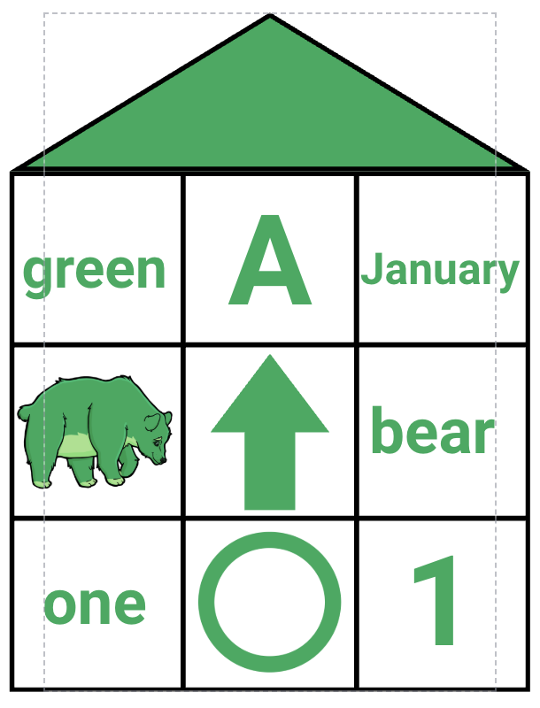
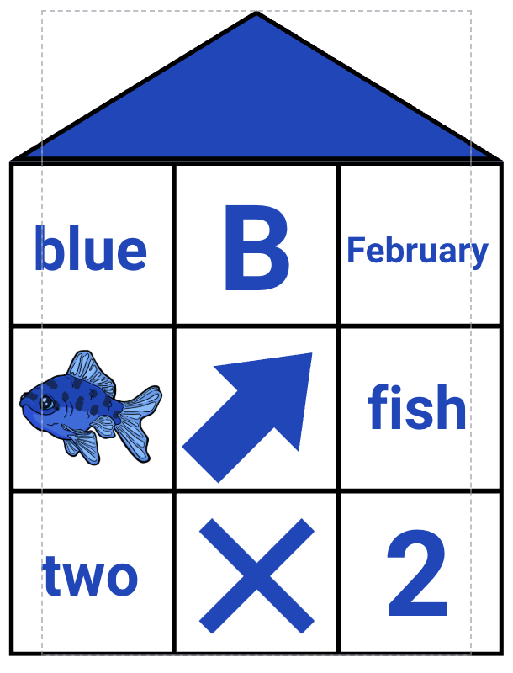
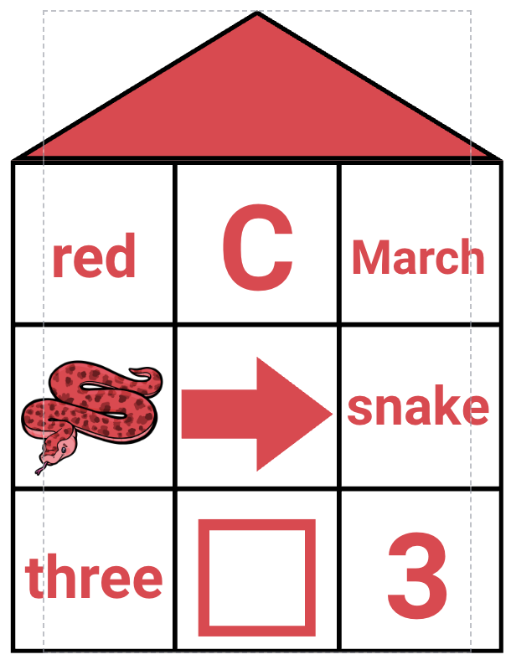
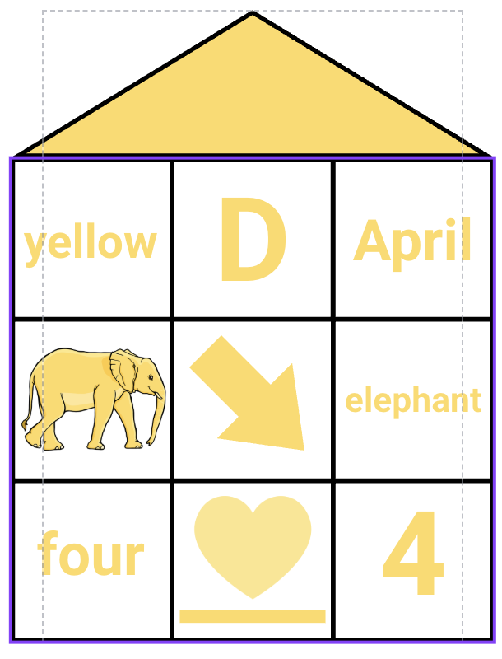
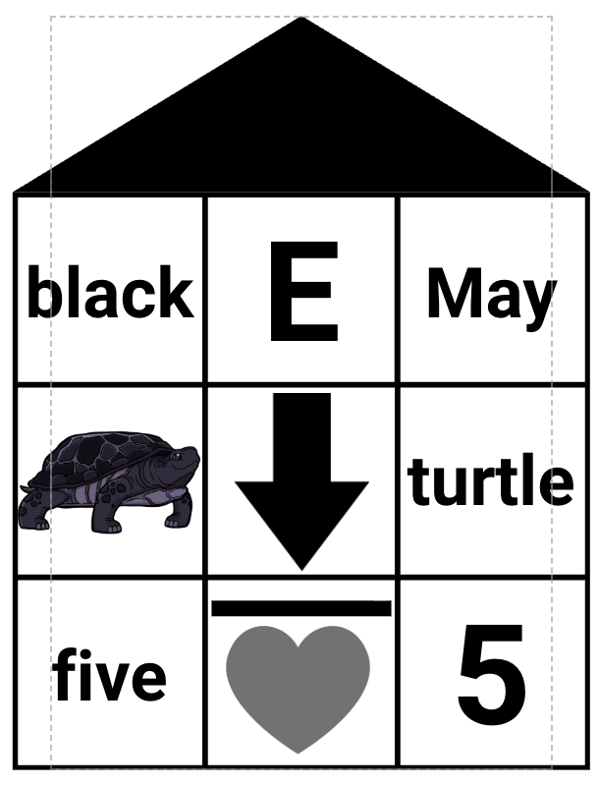
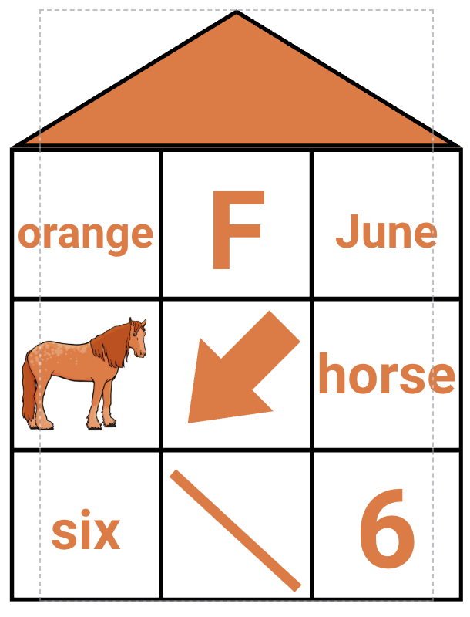
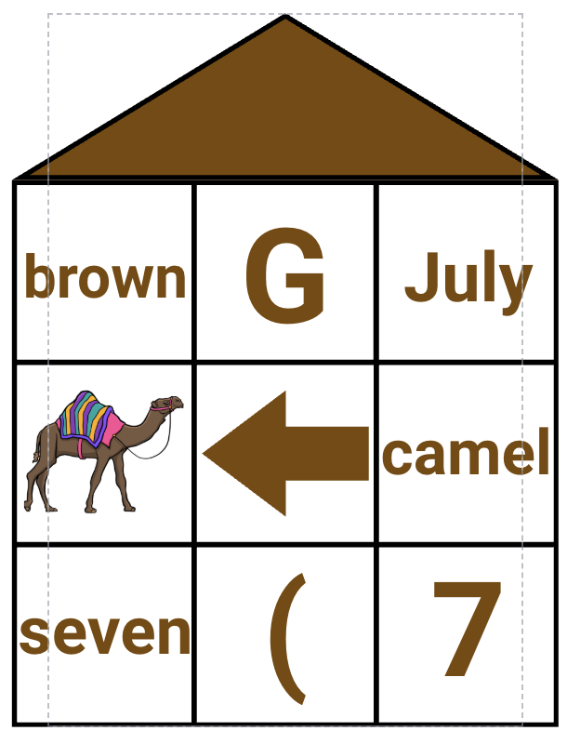
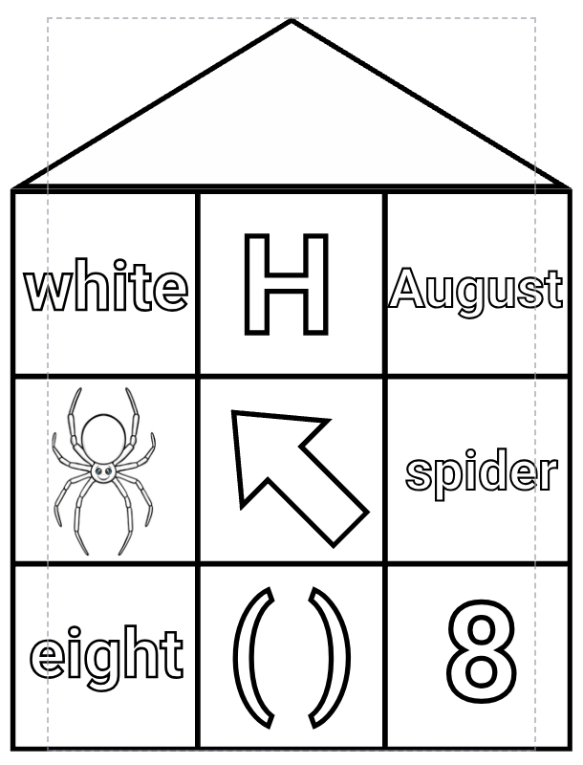
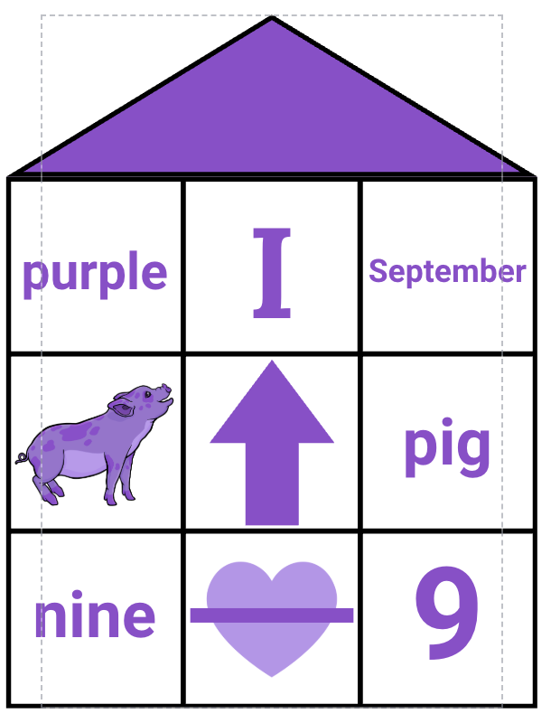
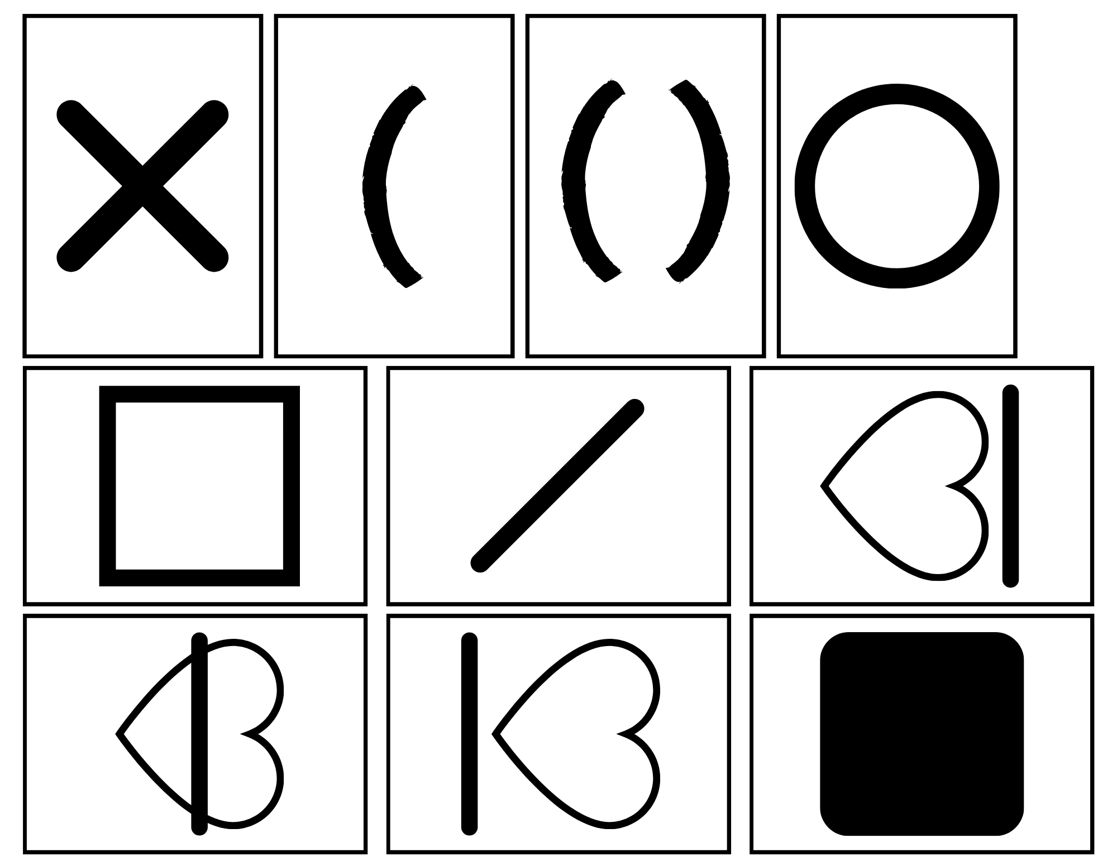
Equipping Minds Card Activities
Processing Activities
* If a student does not know all of their colors, letters, numbers, or animals that are on the cards, begin with teaching those things first and then build from there.
* Always model first, take turns, use language, and HAVE FUN!
Processing Exercises
Lay out code cards.
Use deck and have them “say what they see” using color say “blue under blue, green under green…” (you could split the deck into parts and do this same activity with letter, number, animal, word (if able), symbol, direction)
This is a great way to assess the students if they are new to you.
Lay out code cards in order.
  sort by color
  sort by number
  sort by animal
  sort by the word
  sort by the letter (can also sort by sound)
  sort by symbol - circle, , box, line under, line above, slash, left parenthesis, parenthesis,
line through the middle
Working Memory Activities
Lay out code cards.
You will be laying cards under the code cards just like you do in the processing activities. This time you will lay them alternating 2 qualities form the card. Start by saying number on one card and color on the next card.
  “Check” using appropriate language/ -if/then statements example: If a student says the wrong thing and does not automatically correct themselves say…if this card was color, then whose turn is this (pointing to the card they said incorrectly)
  Be positive, “this is making my brain think,” it should feel “not to easy and not to hard” if you see frustration, go back a step
When ready- alternate 3 qualities: number, color, animal or any other 3 qualities

Slide 3
BLINK CARDS
(can also be used with UNO cards and regular playing cards)
Processing Activities
* Every deck of cards starts in the same way. Just looking and saying what you see. (I see colors, I see shapes, I see numbers…)
Processing Exercises
Lay out 1 card with each color.
Use deck and have them “say what they see” using color say “blue on blue, green on green…”
  To begin with, split the deck in half and take turns.
  Next, split the deck in half and go at the same time racing.
  See how long it takes for child to complete the whole deck.
Using the same method as above, lay out 1 card of each number 1-5. Say, “1 on 1, 2 on 2…”
Using the same method, lay out 1 card of each shape. Before playing, determine what you are going to name some of the shapes.(EX. lightning on lightning, or bolt on bolt and flower on flower or cloud on cloud.)
Place two cards down for the discard piles. Split the deck in half. Each player begins with 3 cards facing up. Take turns matching either number, color, or shape. Continue saying “green on green” or “moon on moon”. To help a child say, “check your numbers, check your shapes, check you colors”. This will eventually become a race.
Working Memory Activities
YOU will be laying cards on top of each other in two different stacks. Place card on first stack and child will be saying the number. Place card on the second stack and child will be saying color
  “Check” using appropriate language/ -if/then statements example: If a student says the wrong thing and does not automatically correct themselves say…if this card was number, then whose turn is this (pointing to the card they said incorrectly)
  Be positive, “this is making my brain think,” it should feel “not to easy and not to hard” if you see frustration, go back a step
When ready- alternate 3 in 3 different stacks: number, color, shape
(it does not matter what shape
or number is on the card)
(it does not matter what shape or color is on the card)

Slide 4
SPOT IT
Processing and Working Memory Exercises
Select one card as the constant card and say what you see on the “constant card” in a full sentence. “I see a green frog.” Next, each player will draw a card and find the match on the constant card and say, “I see two green frogs.” Begin by taking turns and eventually play competitively.
Using the same constant card from before, turn it upside down and have child recall the items on the constant card. Give simple prompts like “what did you see that was blue?” Or “what do you see that flies?”
Using the same constant card the child already knows, add another constant card. Flip the original constant card over and play with the new one face up. Each player will take turns drawing a card and finding the match to both constant cards. Eventually you will turn both constant cards over and play in the same manner saying, “I see two green frogs and two yellow squirrels.”
Place 9 cards face up on the table in a 3x3 grid. Find 3 matches of the same item and say, “I see 3 green frogs”. Pick the 3 cards up and replace with new ones. Continue until there are no matches left.
Place 12 cards face up in a 4x4 grid. Find 4 matches and say, “I see 4 green frogs”. Continue until their are no matches left.
Place 9 cards face down in a 3x3 grid, leaving only the middle card face up. This will become the constant card for the game. On you turn, flip over 2 cards with the goal of finding a set of 3 matches that include the constant card in the middle. If you don’t have a set of 3, flip them back face down. Taking turns flipping over two cards at a time saying what you see that matches the constant card in the middle. If you see 3 of the same thing, remove the two cards you flipped over and replace them with two new cards placing them face down. Do not remove the constant card in the middle. Play continues until you have no more cards left. You may need to add a 10th card if you are certain there are no sets of 3.

Slide 5
Tic-Tac-Toe
Cognitive Skills: Visual Memory, auditory processing, working memory, logic and
reasoning
Play tic-tac-toe on one board. For a more challenging game, use unifix cubes and have one person turn their cube to the right and the other turn their cube to the left.
Play tic-tac-toe on 2 boards. Player one plays on the top board and player 2 plays on the bottom board. If player one goes on the top right corner of their board, player 2 cannot go on the top right corner of their board.
Play tic-tac-toe on 2 boards. Cover every space with a cube of one color on the top board and a different color on the bottom board. Remove cubes and the blank space becomes the space where you are. The same rules apply, if player one goes on the top right corner of their board, player 2 cannot go on the top right corner of their board.

