Slide 2
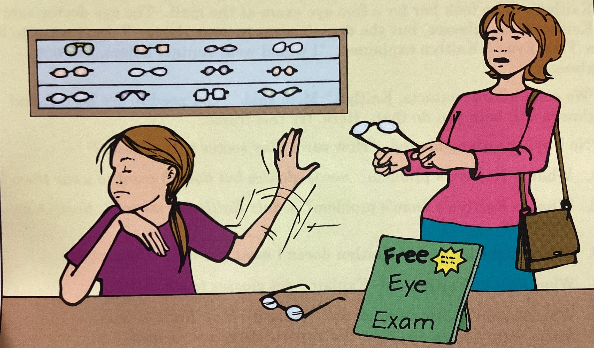
nouns
adjectives
verbs

Slide 3
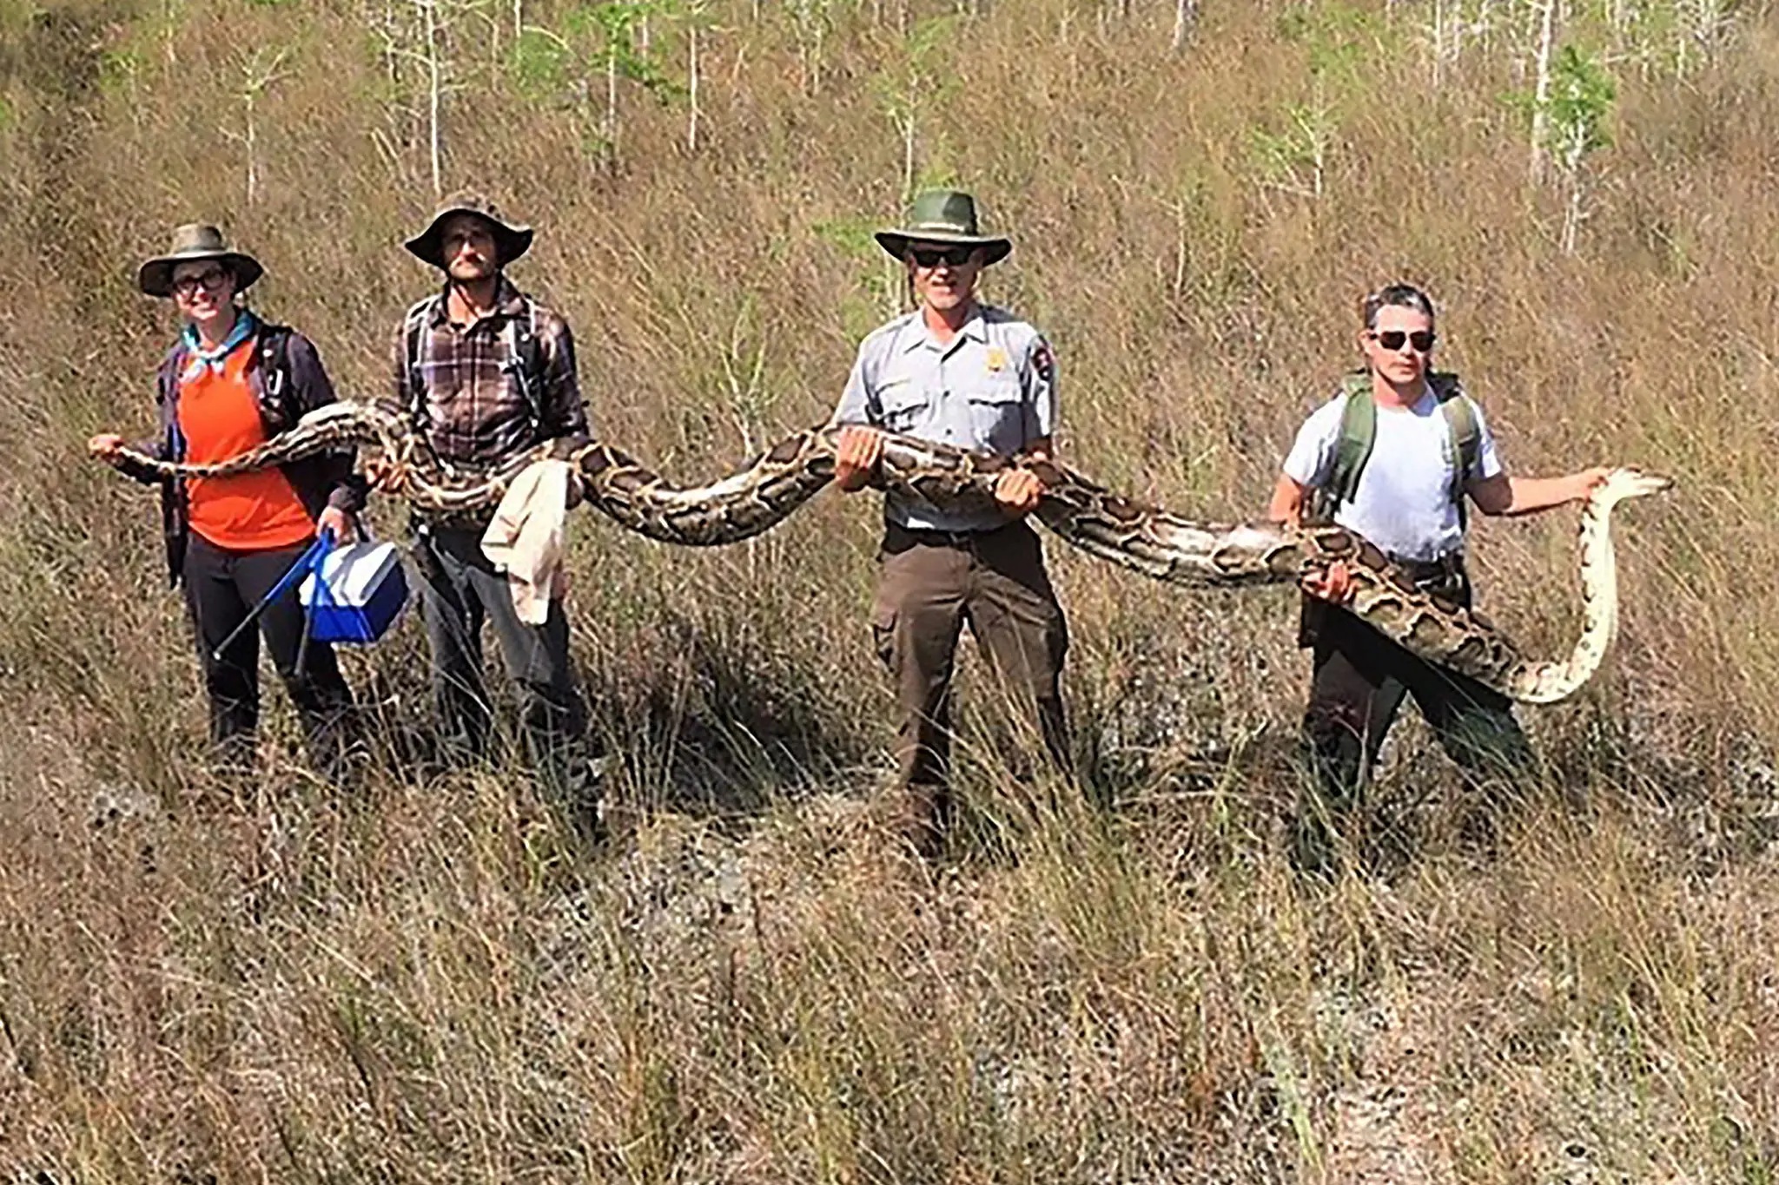
nouns
adjectives
adverbs
verbs

Slide 4
nouns
adjectives
verbs

Slide 5
nouns
adjectives
verbs

Slide 6
nouns
adjectives
verbs

Slide 7
nouns
adjectives
verbs

Slide 8
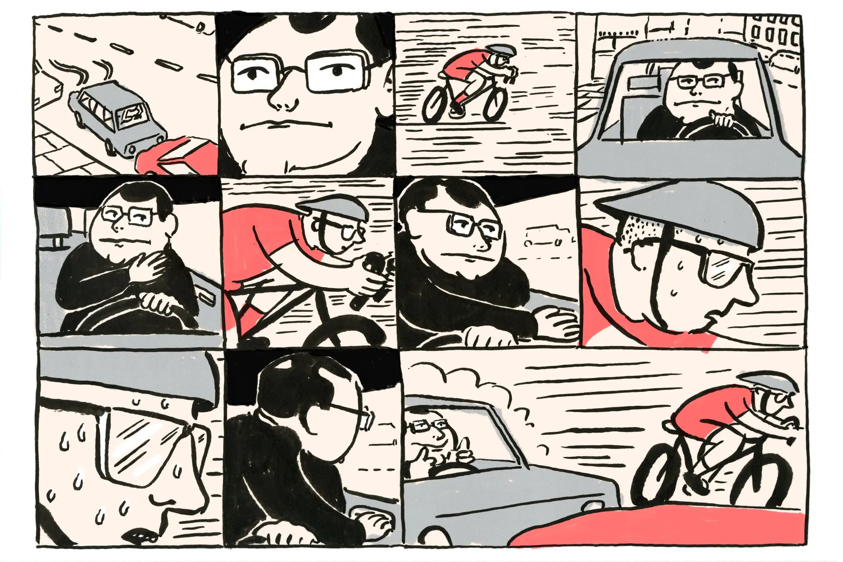
nouns
adjectives
verbs

Slide 9
nouns
adjectives
verbs

Slide 10
nouns
adjectives
verbs

Slide 11
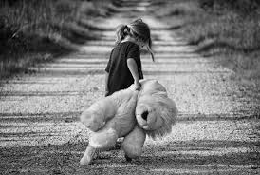
nouns
adjectives
verbs

Slide 12
nouns
adjectives
verbs

Slide 13
nouns
adjectives
verbs

Slide 14
nouns
adjectives
verbs

Slide 15
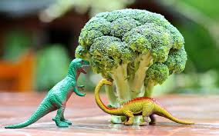
nouns
adjectives
verbs

Slide 16
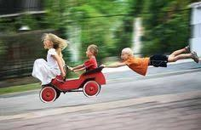
nouns
adjectives
verbs

Slide 17
nouns
adjectives
verbs

Slide 18
nouns
adjectives
verbs

Slide 19
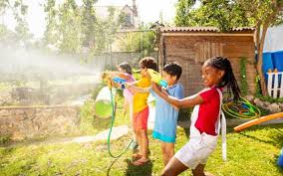
nouns
adjectives
verbs

Slide 20
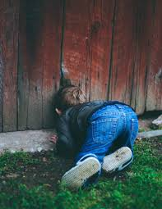
nouns
adjectives
verbs

Slide 21
nouns
adjectives
verbs

Slide 22
nouns
adjectives
verbs

Slide 23
nouns
adjectives
verbs

Slide 24
nouns
adjectives
verbs

Slide 25
nouns
adjectives
verbs

Slide 26
nouns
adjectives
verbs

