Slide 1
Naturalistic or Biblical View of Human Development: Renewing the Mind
Dr. Carol Brown Ed.D

Slide 2
Our Son’s Story
Traumatic Birth
Language Processing Disorder
Receptive/Expressive Language
Symptoms of:
Dyslexia
Dyscalculia
Dysgraphia
IQ Composite: Below Average
Psychologists said: low expectations, working memory, and processing cannot be changed.
Attended Boyce College
Aug. 2011 – Dec. 2014
Biblical Counseling Degree
GPA: 3.2
Educational & Cognitive Therapist
Married 2018
Father 2021

Slide 3
Developmental theories inform our perspectives, expectations, and limitations of learners who have intellectual, behavioral, and physical challenges
LOW EXPECTATIONS: Decide how much children can learn before they even start based on a diagnosis and IQ
LACK OF CURRICULUM: They tried but didn’t have the right tools to help
FOCUS ON ACCOMMODATIONS, MODIFICATIONS, STRATEGIES, MEDICATION,OT, PT, and SPEECH
LACK OF BELIEF THAT THE BRAIN CAN CHANGE
BELIEF IN A CRITICAL AGE
LIMITED FAITH-BASED SCHOOLS

Slide 4
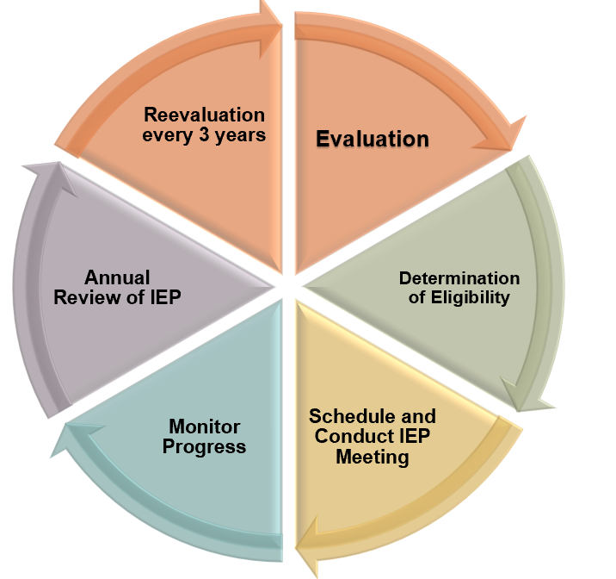
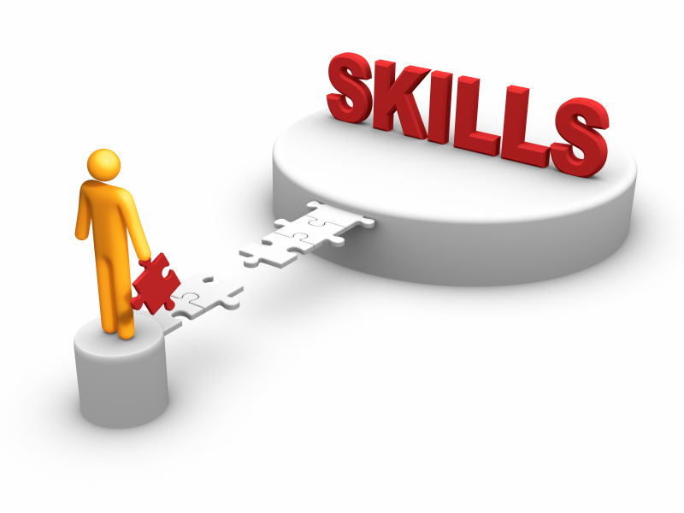
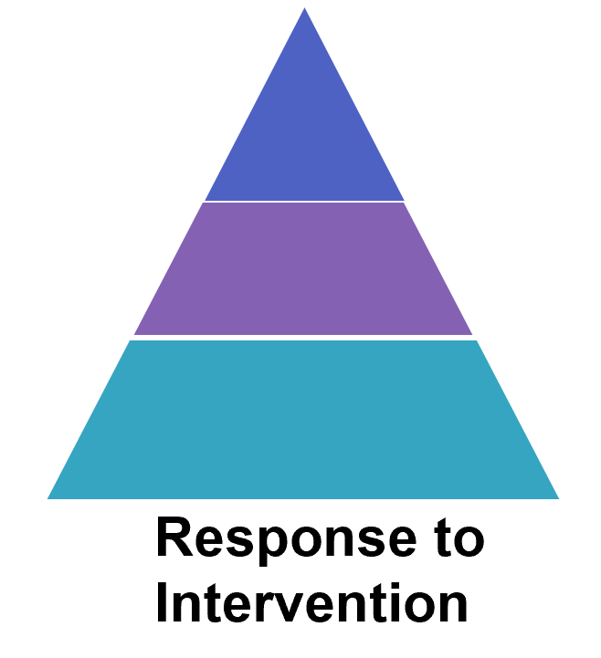
Achievement Gap
Potential
Referral
Academic
Achievement
Tier 3
Tier 2
Personalization
Differentiation
Tier 1
Students Who Struggle Early Rarely Catch Up

Slide 5
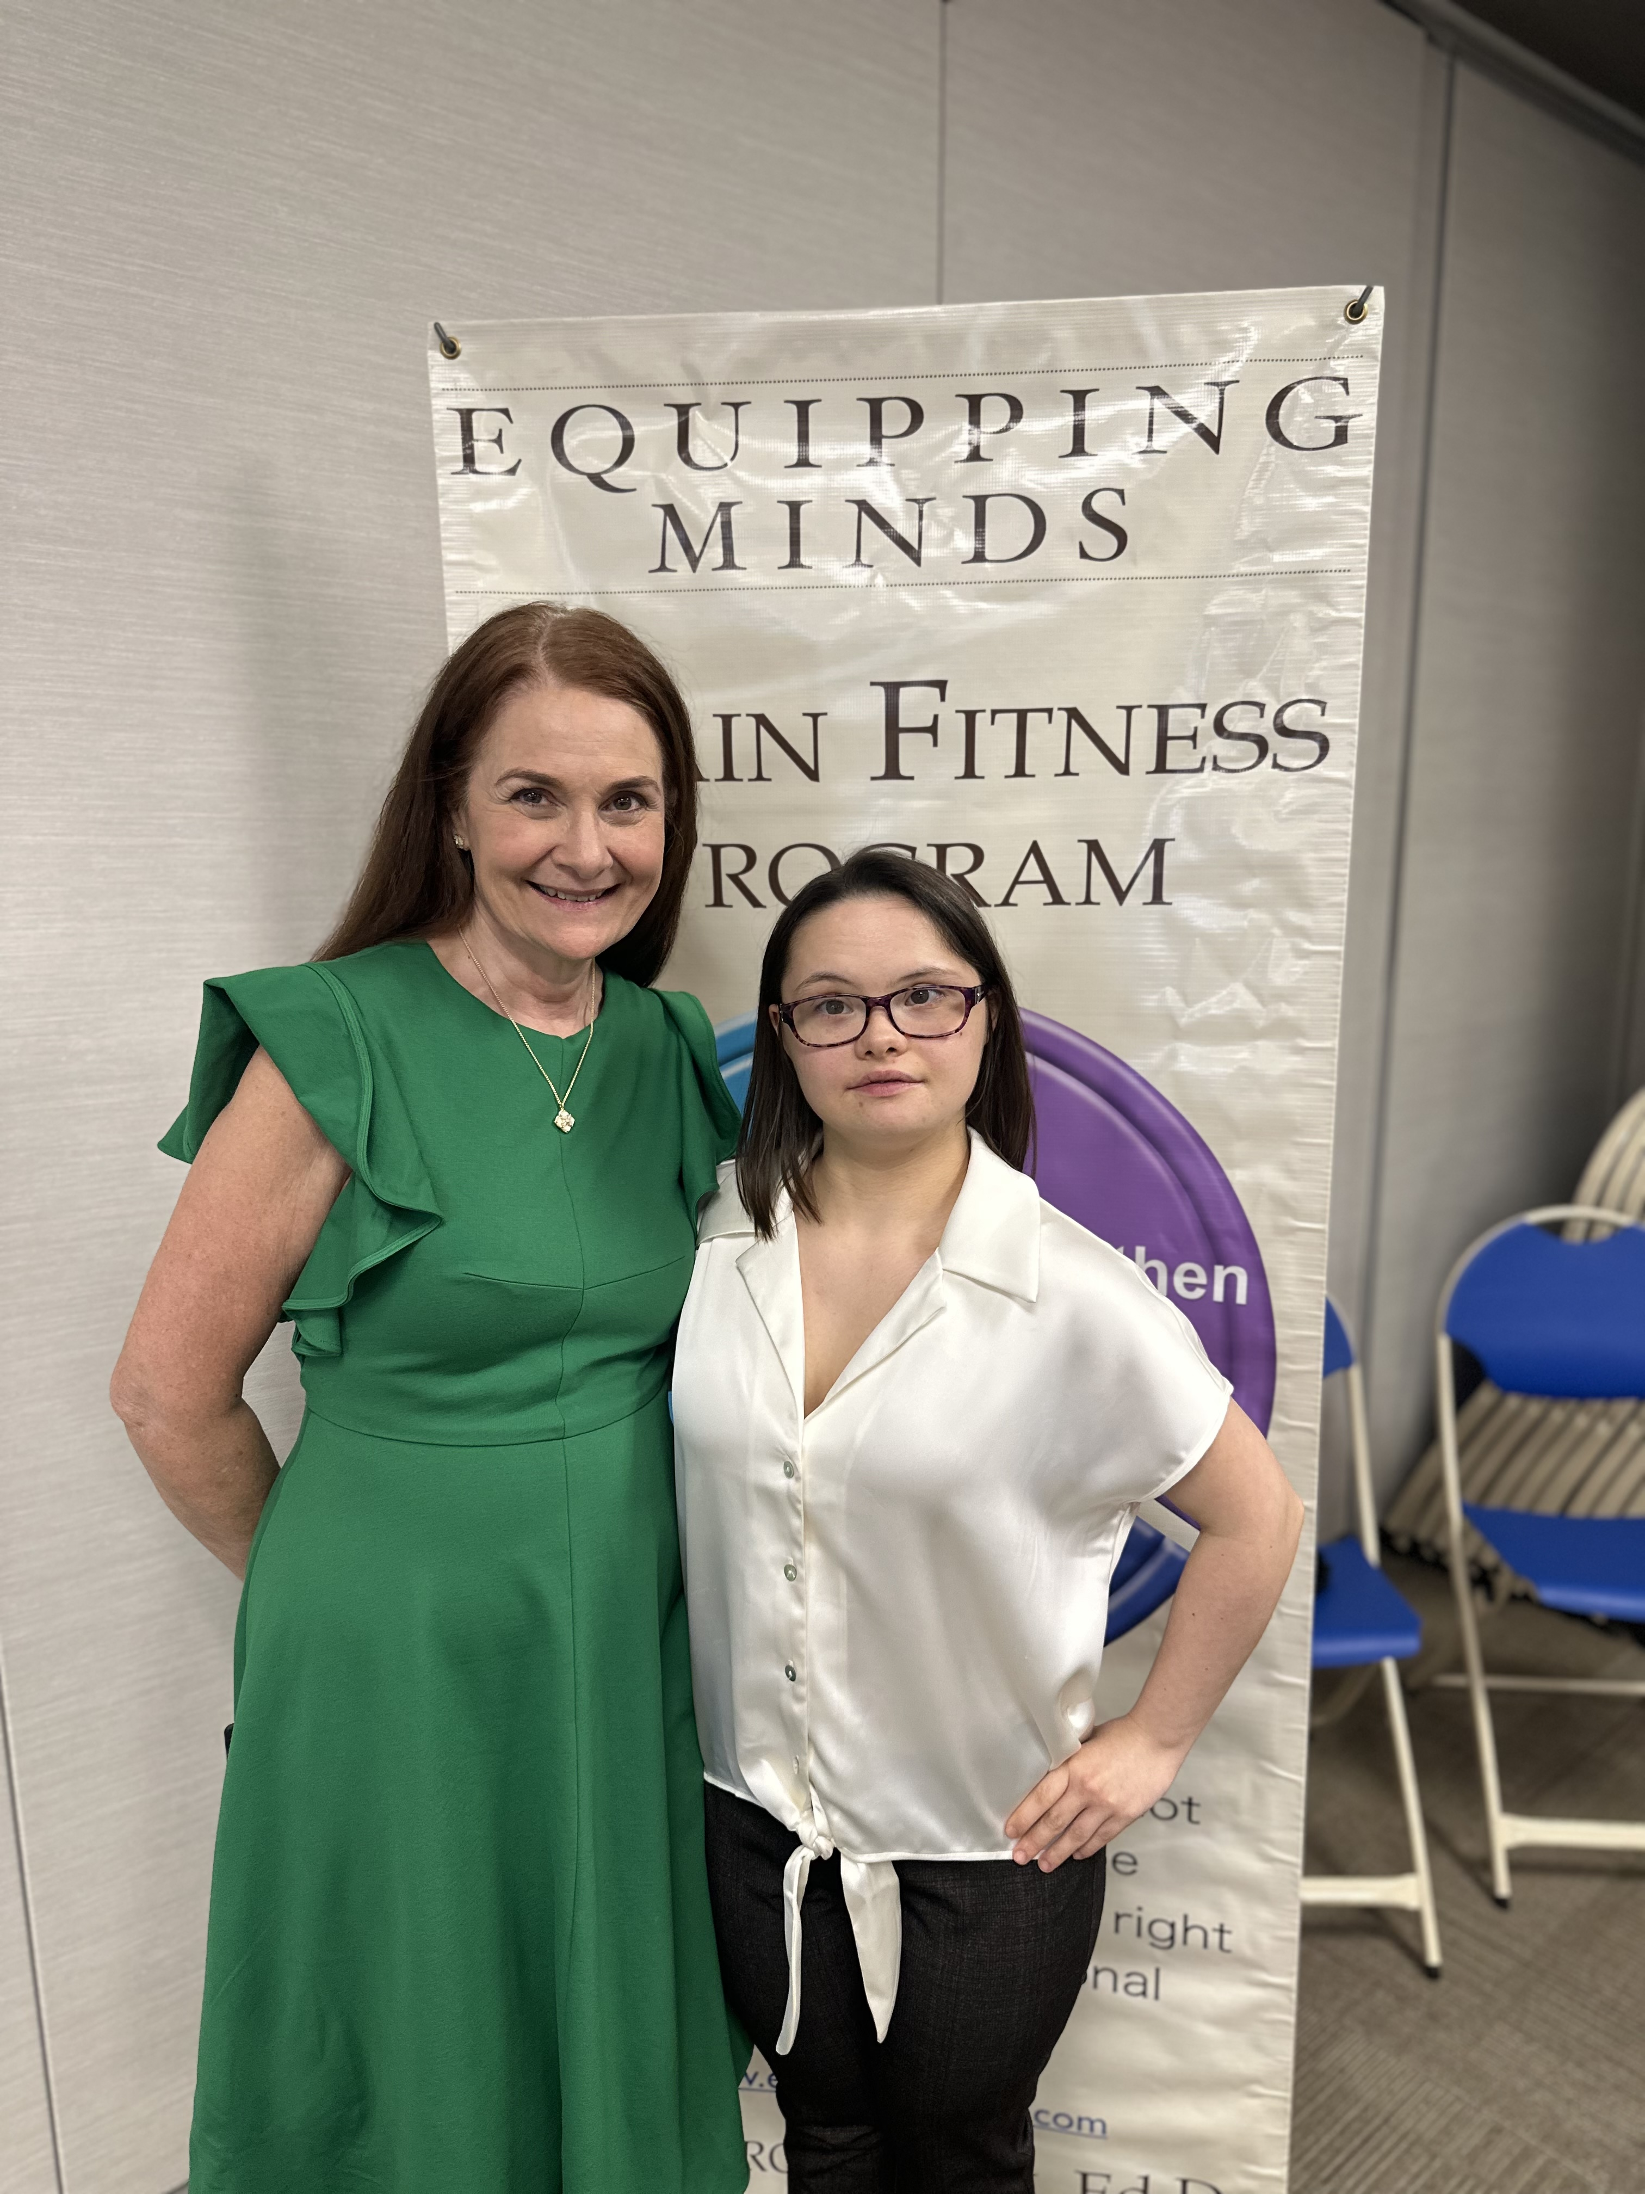
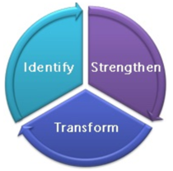
In 3rd grade, her parents heard the words,
”Rose can’t learn anymore. ”
Academic Gains after 9 Weeks
Winter 12
Fall 11
Equipping Minds
Cognitive Development Exercises
12 Weeks lead to a 4 year case study

Slide 6
Dr. Reuven Feuerstein Cognitive Psychologist 1921-2014
Theist: Orthodox Jew who believed we are created in the image of God. His religious beliefs were the foundation for his theories of cognitive development.

Slide 7
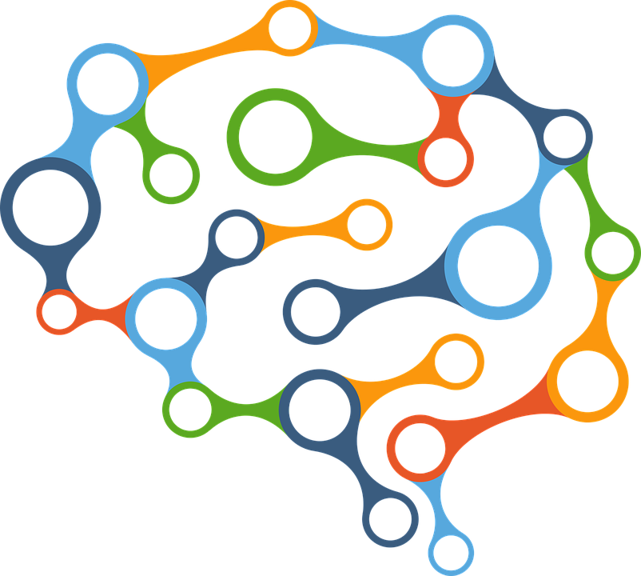
Intelligence is modifiable regardless of age, neurodevelopmental conditions, genetics, and developmental disabilities.
Structural Cognitive Modifiability
1. Human beings are shaped by:
Environment
Human Biology
Mediation
5 Decades
PROVEN
SCM
Mediation Learning Experience
Instrumental Enrichment
2. Intelligence is adaptive
2000+ Research Studies
3. The brain is plastic and can generate new structures through external and internal factors.

Slide 8
Jon Amos Comenius:1592-1670 Father of Modern Education & Developmental Psychology
*Theologian, Educator, and Philosopher
*Image of God, Scripture & Nature, Salvation of Humanity
*Embraced Science, a wholistic view, All Truth is God’s Truth
*EVERYONE should be educated regardless of intellectual ability, boys and girls, rich and poor
*Right of Inclusion for diverse learners
*Unlimited Potential of the Mind- Neuroplasticity
*Life Long Learning
*Joy of Learning
*Sought throughout Europe to reform education
*System of progressive instruction
*Multi-sensory instruction
*First children’s picture book: Orbitus Pictus
*Exercise, play, nutrition, work, and sleep

Slide 9
Neuroplasticity is the most important discovery in all of neuroscience as it confirms the brain is built to change in response to experience and training, enabling learning. Boleyn-Fitzgerald
Comenius understood there is no truth or intellectual endeavor Christ did not bring into being.
God in Christ is the Creator of all things (Gen 1:1, Col.1:15-16, Heb.1:2), the sustainer of all things (Col. 1:16-18 Heb 1:3), and the reconciler of God with humanity (Col.1:19-20).
God creates all of humanity in His image for His purposes and glory (Gen 1:28-29, Isaiah 43:7).
These were essential truths for Comenius and are relevant for Christian educators and psychologists today as the Bible is the lens through which we view human life and provides the message for salvation.
Since man is created in God's image, he is “capable of acquiring knowledge of all things.” Comenius saw the mind's unlimited potential because he saw humanity from a biblical worldview of human development.
“It is evident that man is naturally capable of acquiring a knowledge of all things, since, in the first place, he is the image of God… If a thousand years were granted to man, in which, by grasping one thing after another, he might continually learn something fresh, he would still find some spot from which the understanding might gain fresh objects of knowledge. So unlimited is the capacity of the mind that in the process of perception, it resembles an abyss. The body is enclosed by small boundaries: the voice roams within wider limits; the sight is bounded only by the vault of heaven; but for the mind, neither in heaven nor anywhere outside heaven, can a boundary be fixed.”

Slide 10
To have a voice for those who have no voice and sit at the academic table
Research Study with Specific Learning Disorders
Thirty-two students with a diagnosed specific learning disorder (SLD) were randomly assigned to
one of two groups. Half of the students trained with EMCDC (Training Group) and the other
half received extra academic tutoring (Active Control). Each group received training or academic
tutoring for one hour a day, five days a week for 30 hours over 7 weeks.
The Training group showed statistically significant improvements in:
verbal abilities
nonverbal abilities
IQ composite
Science
Training Group made greater improvements in reading, science, language, and
social studies than the Active Control Group.
The Active Control, who received 30 hours of academic tutoring did not make significant
improvements in working memory, nonverbal abilities, IQ, or academic skills.
However, they did make gains in verbal abilities.

Slide 11
Peer-reviewed Published Research

Slide 12
Do not conform to the pattern of this world, but be transformed by the renewing of your mind. Romans 12:2
Changing our mindset
Image of God includes the whole person
Jesus grew in wisdom, and statue in favor with God and man
Scripture says God gives the ability to know Him
To Think, To Know, and To Remember…involve working memory, which can be developed
Science, Education, and Scripture should not be seperated
Neurotheology: Psychology, Neuroscience, & Spirituality
Restoration is a lifelong process

Slide 13
Intervention:
Cognitive Development Therapy
Results: Follow Multi-step Directions
Visualize
Letters
Numbers
Images
Reading/Spelling
Math
Comprehension
Impacts
Improves Behavior and Language

Slide 14
Nethra

Slide 15
Tic Tac Toe

Slide 16
Doulos Discover School

Slide 17
Malawi teachers Kenya teacher

Slide 18
Mexico Brain Fit Seniors

Slide 19
“God Himself has frequently asserted that with Him there is no respect of persons, so that, if, while we admit some to the culture of the intellect, we exclude others, we commit an injury not only against those who share the same nature as ourselves, but against God himself, who wishes to be acknowledged, to be loved, and to be praised by all upon whom He has impressed His image.
Now we do not know to what uses divine providence has destined this or that man; but this is certain, that out of the poorest, the most abject, and the most obscure, He has produced instruments for His glory.”

Slide 20
Cognitive Development
Reasoning
Processing
Comprehension
Working & Long-Term
Memory
Sensory
and
Motor Development
Social
and
Emotional Development
Equipping Minds
Relational
Primitive Reflexes
Confidence
Visual & Auditory
Processing
Language
Self-regulation

Slide 21
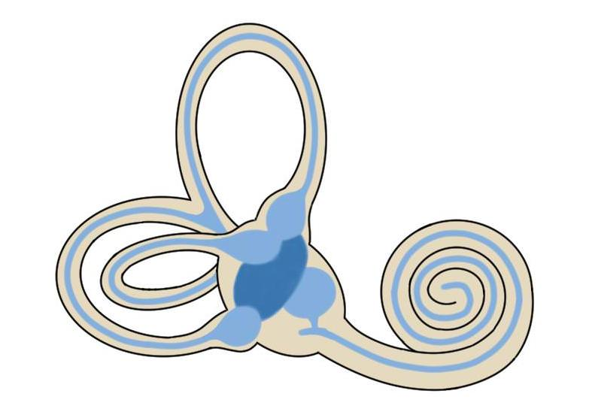
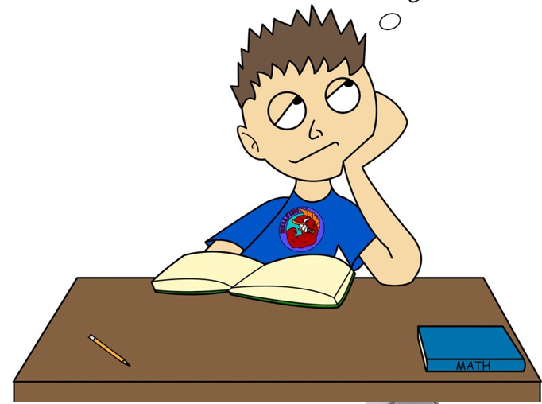
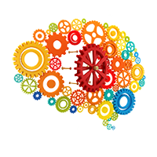
Equipping Minds of Learners
A Holistic-Integrated Approach
Nutritional Therapy
Primitive Reflex Therapy
Vestibular Therapy
Cognitive Development Therapy
Sound Therapy
Mediated Learning Experience
Notes:
specially recorded programs of highly filtered classical music are used to rehabilitate the ear and stimulate the brain. Sound Therapy stimulates the ear by presenting it with constantly alternating sounds of high and low tone within the complex structure of classical music. Stimulation via the sensory pathways re-maps the brain, improving the way we understand and process sound. The brain, in turn, sends signals back to the ear to improve its function. As the ear becomes open and receptive to high frequency sounds these are then passed on to the brain. Research has shown that brain function is improved through high-frequency sound. Participants will also listen to sound therapy.
The teacher is a mediator who invites the learner to
identify a problem, to analyze it, to use inductive thinking processes to develop a strategy
for its solution, and connect it to other knowledge networks. Teachers who apply these
principles of mediation enable learners to find a greater level of success as independent and active learners.43
Nutrition exercise
Cognitive development
Sensory development
Motor development

Slide 22
Stories of Hope

Slide 23
Equipping Minds Success Stories

